Slide 1
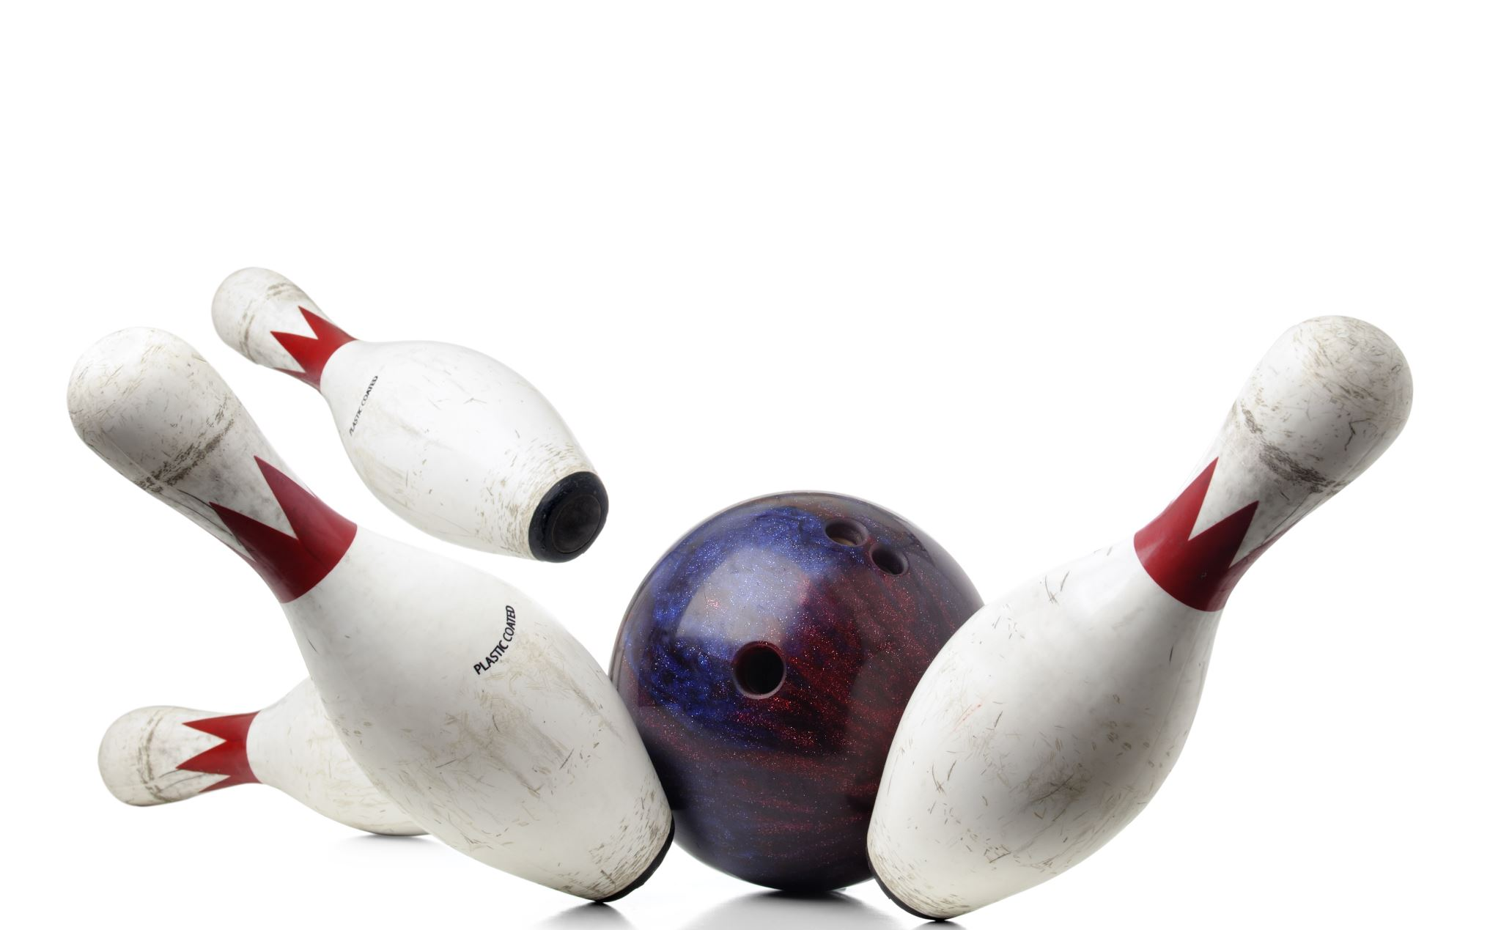
Bowling IOT project
progress and future plan

Slide 2

Overview
Our project is a mini bowling challenges game fully controlled by a mobile app and detecting hand movement. The game is basically built of three parts:
A slide for the balls that moves side-ways and angularly and can throw the balls, and it will be controlled by hand movement and a button.
XY robot with a base that arranges the pins according to a specific arrangement input and detects which pin has fallen in every round.
A mobile app which controls a robot by sending the desired arrangement and receives the result and saves it.

Slide 3

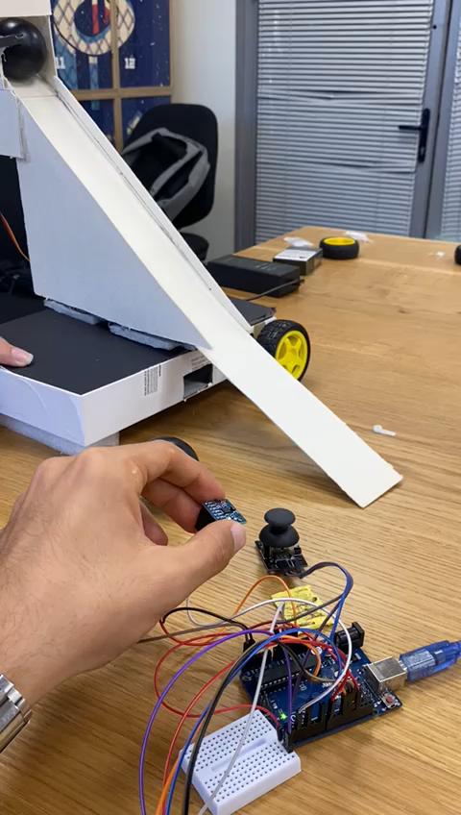
What is done?
At this point we have made a motored slide that moves right-left and angularly according to the move of the player’s hand and slides the ball when clicking on a button. The slide is controlled by “glove" worn on the player’s hand, the “glove” contains a gyroscope which reads the and movement and a button that changes the slide mode –left-right, angular, throwing a ball–. The gyroscope and the button are connected to an Arduino which transfers the data from theme to the slide’s Arduino using Wi-Fi, while the slide’s Arduino moves the slide accordingly using tow step motors connected to the wheels, one servo for the angular movement and another servo for ball release.

Slide 4

Then we faced some difficulties

Slide 5

Building problems
While building the slide we ran into tow main construction problems:
the material we were using was cartoon which is weak, the thing that adding the heavy weight of the ball cause the slide to crash. This issue was solved without the need of changing the material using trusses that made the slide stronger and steadier.
The light weight of the slide and the heaviness of the balls caused balance problem where the slide fell because of the balls it is carrying. To solve this issue, we had to enlarge the slide’s base and find the perfect placing for the ball magazine.

Slide 6
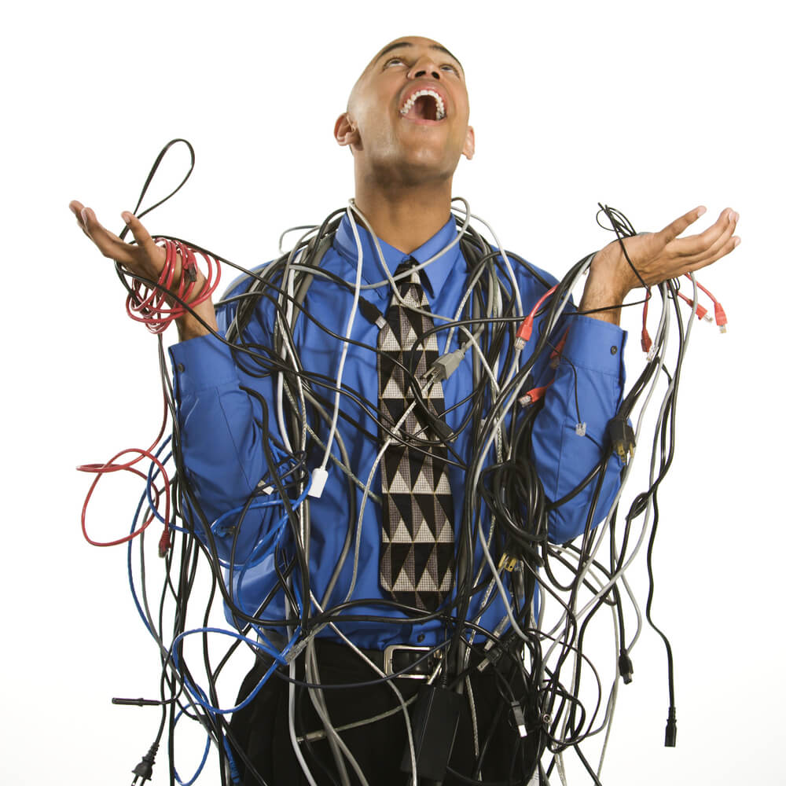
Cable management
The gyroscope and the button in the glove Were originally connected with the Arduino of the slide by wires which has caused two main problems. The first one is inconvenience, having these short wires forces the player to be close to the slide and limit his movement which causes a bad user experience.
The second problem is the instable connection of the wires as they tend to disconnect frequently and cause control loss over the slide.
The solution for this problem was using two different Arduino boards, one for the slide and another for the gyroscope and the push button and connecting them using Wi-Fi, this way there are no visible wires needed and the problem is solved.

Slide 7

Software problems
Using the gyroscope was problematic because of the high sensitivity which made it impossible to control the slide properly and accurately.
To solve this problem, we searched for and used some libraries that are specific for using the gyroscope and controlling its sensitivity.

Slide 8

What’s next?
Roadmap and final product

Slide 9

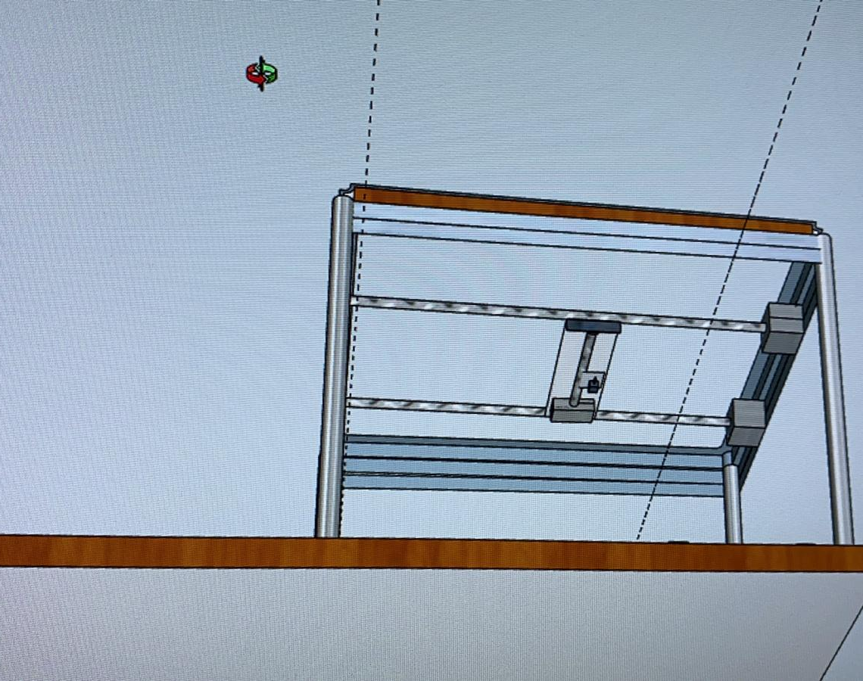
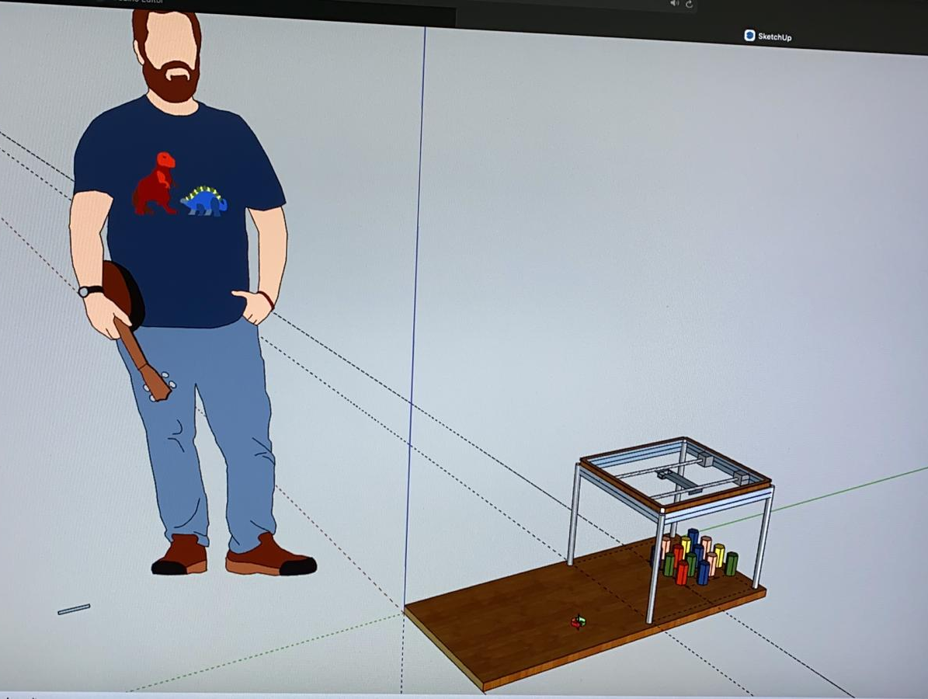
XY pins placer
The next step is building an XY robot which is responsible for placing the bowling pins in the right places one by one as given as an input for the robot. This robot will put every pin in its place by using three step motors as two of them are responsible for the movement in Y coordinate and the third is responsible for the X coordinate. The movement is made using lead screws connected to the step motors

Slide 10
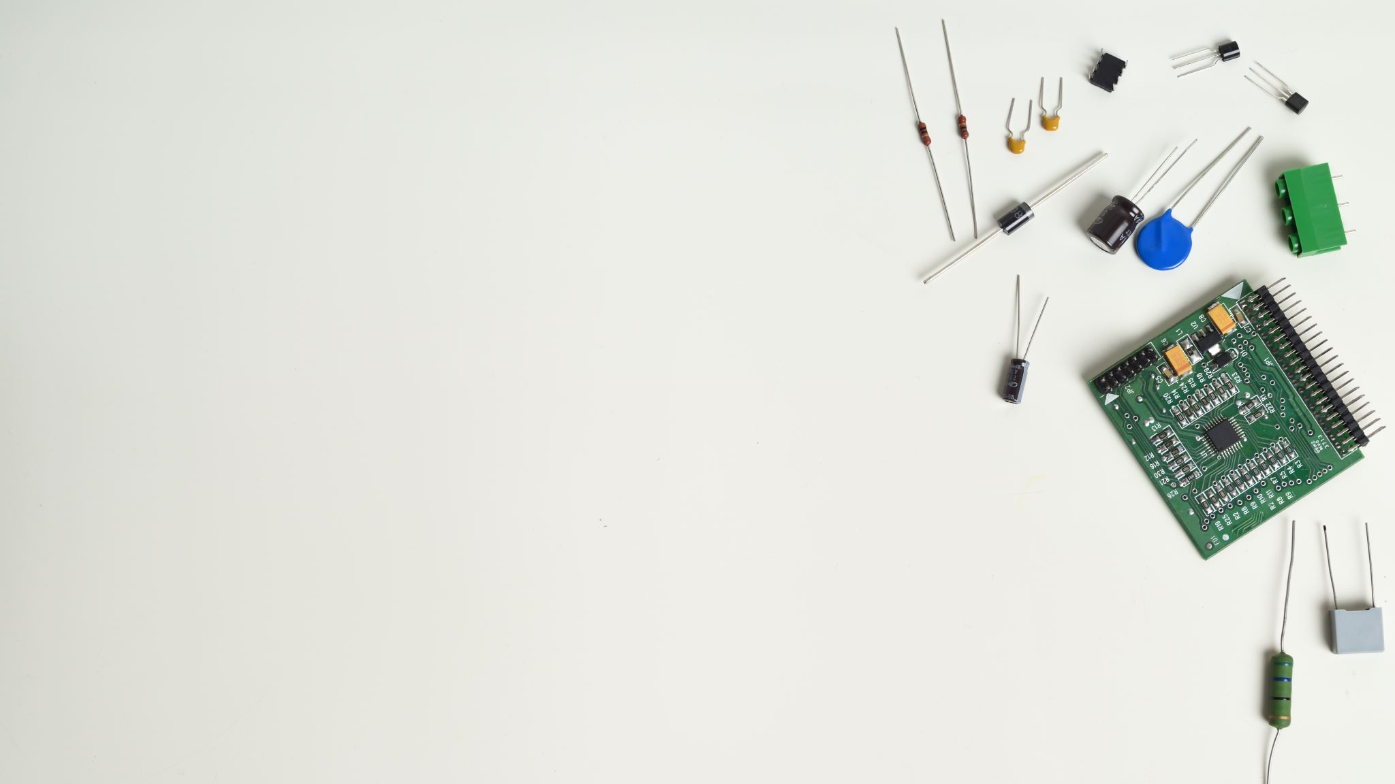
The base
The base of the robot will have 14 points as every point will be a possible position for a pin.
Each one of the points will have a circular metal area connected to an electric circle which can be closed by a similar metal placed on the bottom of thee pins so a closed electric circle in a specific point will represent the existence of a standing pin on that point, and the change of the number of closed circles will be the number of the falling pins. This implementation may help us show which pins have fallen and which are still standing.

Slide 11

Mobile app
Finally, we are going to build an Android app which will allow the user to choose the arrangement of the pins –from a built-in possibilities or costume arrangement– and will show the history of results and the top results. The app will be responsible to sending thee pins arrangement to the robot and receive the result after every round and save it, this connection will be via Wi-Fi as the robot’s Arduino will have a Wi-Fi chip.

Slide 12
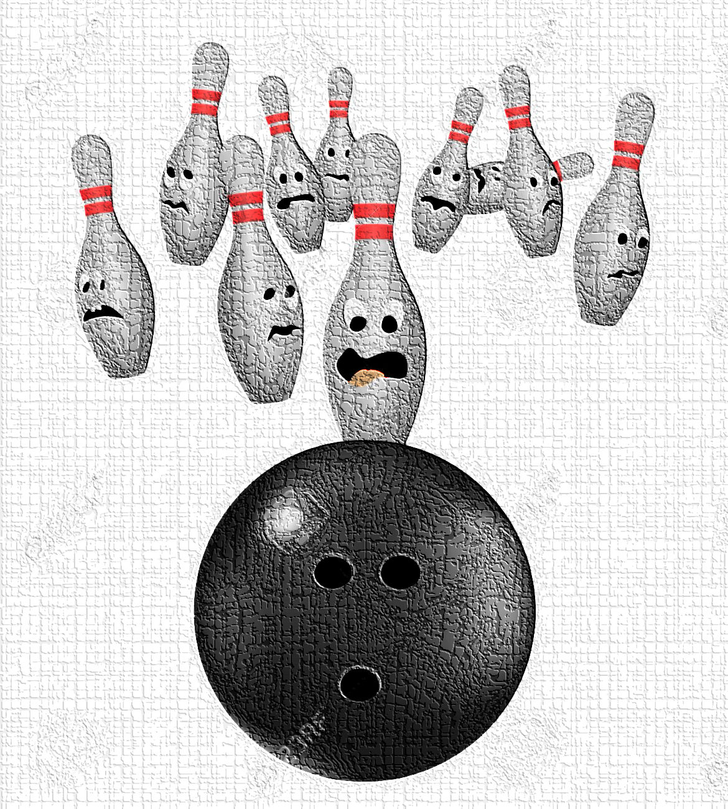
The end

